Slide 1
Chapter 2
Microcontroller Architecture

Slide 2
Table of Contents
Introduction
Microcontroller Architecture
Software Development Platforms
Digital Input and Output
Interrupts and Power Management
Timing Operations
Conversion Between Analog and Digital Values
Digital Communication
Memory Operations
Real-time Operating Systems
LCD, Touch Screen, and Graphical User Interface Formation
Introduction to Digital Signal Processing
Introduction to Digital Control
Introduction to Digital Image Processing
Advanced Topics

Slide 3
LAYOUT
Introduction
The STM32F4 Microcontroller
  Central Processing Unit
  Memory
  General Purpose Input and Output Ports
  Clock and Timer Modules
  Analog Modules
  Digital Communication Modules
  Other Modules
Assembly Language
  The Arm® Cortex™-M4 Instruction Set
  Executing Machine Language Code in the Microcontroller
The STM32F4 Board
  General Information
  Pin Layout
  Powering the Board and Programming the Microcontroller on It

Slide 4
Introduction
This chapter introduces the architecture of the STM32F4 microcontroller. Architecture consists of
  hardware modules
  software commands, (aka assembly language)
We will see each hardware module as microcontroller unit and peripheral unit in detail in the following chapters.
Here, we aim to show the connection between these modules.

Slide 5
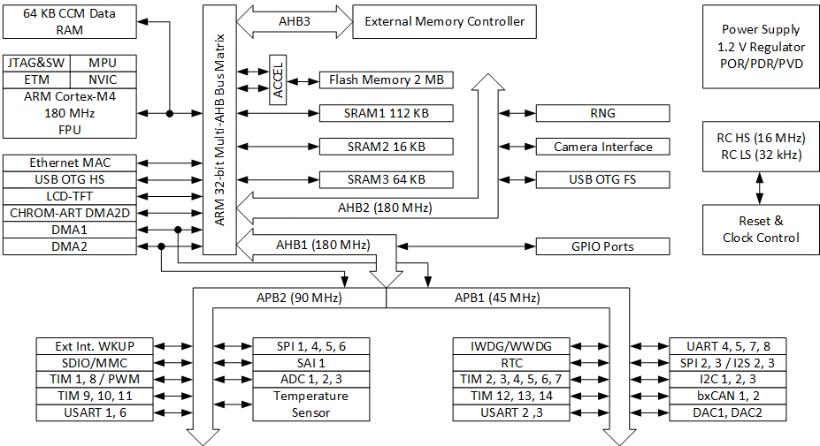
The STM32F4 Microcontroller
Functional Block Diagram of the STM32F4 Microcontroller

Slide 6
Central Processing Unit
CPU is responsible for organizing all operations within the microcontroller.
The programmer constructs his or her algorithm and forms the corresponding C, C++, or assembly code.
This code is debugged and embedded into flash memory of the microcontroller by the help of an integrated development environment.
The CPU executes the commands by using its resources (such as peripheral units).
Executing Python codes on the microcontroller is different.

Slide 7
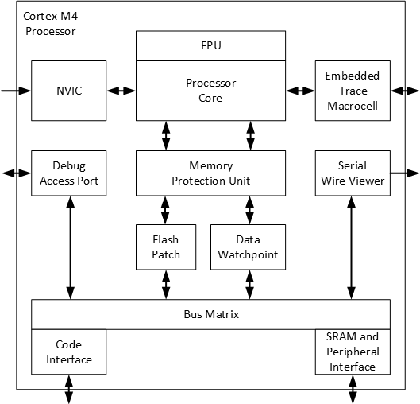
Central Processing Unit
Block diagram of the CPU for the STM32F4 microcontroller

Slide 8
Central Processing Unit
CPU components
Nested Vectored Interrupt Controller
Debug Access Port and Serial Wire Viewer
Memory Management Units
Embedded Trace Macrocell Module
The Bus Matrix
Registers

Slide 9
Memory
Data to be processed and code to be executed is stored in
memory of the microcontroller.
Memory Types
Random Access Memory (RAM)
  Stores temporary data.
  Contents of RAM are lost when the power fed to it is turned off.
Read Only Memory (ROM), Flash memory
  stores code or data permanently.
  Even if the power fed to it is turned off, contents of ROM are kept.

Slide 10
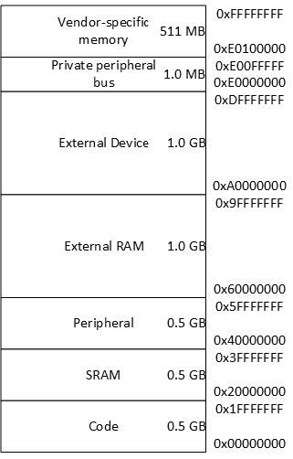
Memory
The STM32F4 microcontroller memory map

Slide 11
Memory
Memory Related Modules
Direct Memory Access (DMA) module.
Flexible Memory controller (FMC).
Chrom-art accelerator controller (DMA2D) module.

Slide 12
General Purpose Input and Output Ports
The microcontroller needs a medium to transfer data to and from the outside world.
This is done by using ports of the microcontroller. A port is a collection of pins grouped together.
Each pin can be taken as a wire with its electronic control circuitry.
The STM32F4 microcontroller has eight input and output ports called A, B, C, D, E, F, G, and H. Total number of pins in these ports is 114.

Slide 13
Clock and Timer Modules
With each clock cycle (MCLK), the processor performs an action that corresponds to an instruction phase.
Cycles Per Instruction (CPI) is the average number of clock cycles required for a processor to execute an instruction.
Millions of instructions per second (MIPS) is a unit used to characterize a processor’s performance and corresponds to the processor frequency (MCLK) divided by the average cycles per second (CPI).

Slide 14
Analog Modules
When we want to process an analog signal via the STM32F4 microcontroller, we will need an analog to digital converter (ADC).
In the same manner, we will need a digital to analog converter (DAC) if we want to feed an analog circuit via the STM32F4 microcontroller.
The STM32F4 microcontroller has specific modules to handle the ADC and DAC operations.

Slide 15
Digital Communication Modules
Digital communication modules are used to communicate with external devices using dedicated communication protocols.
The STM32F4 microcontroller has the following modules for digital communication.
  three inter integrated circuit (I2C) modules
  four universal synchronous/asynchronous receiver/transmitter (USART) modules
  four universal asynchronous receiver/transmitter (UART) modules
  six serial peripheral interface (SPI) modules
  two controller area network (CAN) modules
  one universal serial bus on-the-go full-speed (USB OTG_FS) module
  one universal serial bus on-the-go high-speed (USB OTG_HS) module
  one ethernet media access control (MAC) module with DMA

Slide 16
Other Modules
There are also other modules under the STM32F4 microcontroller.
We will not deal with them here.
Please see the microcontroller user’s guide for these.

Slide 17
Assembly Language
The Arm Cortex M4F Instruction Set
Forming a Complete Assembly Program
Executing the Machine Language Code in the Microcontroller

Slide 18
The STM32F4 Board Board
  General Information
  Pin Layout
  Powering and Programming the Board

Slide 19
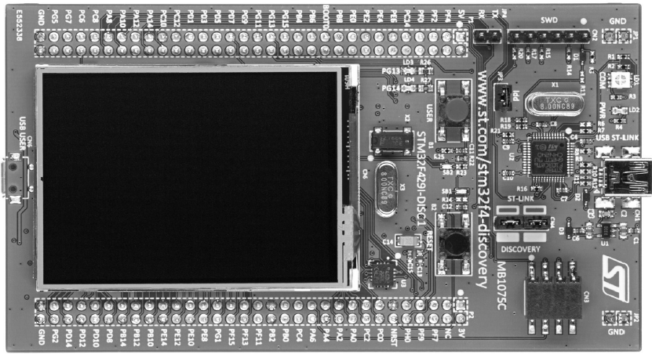
The STM32F4 Board
  General Information

Slide 20
The STM32F4 Board
  The STM32F4 board contains
  STM32F429ZIT6 microcontroller
  On-board ST-LINK/V2-B embedded debugging tool interface
  2.4 inch QVGA TFT LCD
  User and reset push buttons
  Two user LEDs, LD3 being green and LD4 being red
  I3G4250D three-axis MEMS gyroscope
  64 Mbit SDRAM
  Micro-AB connector for USB OTG
  8 MHz external crystal

Slide 21
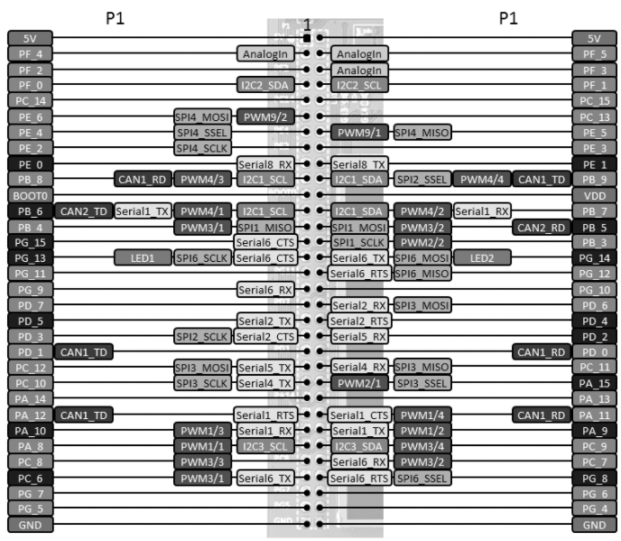
The STM32F4 Board
  P1 header

Slide 22
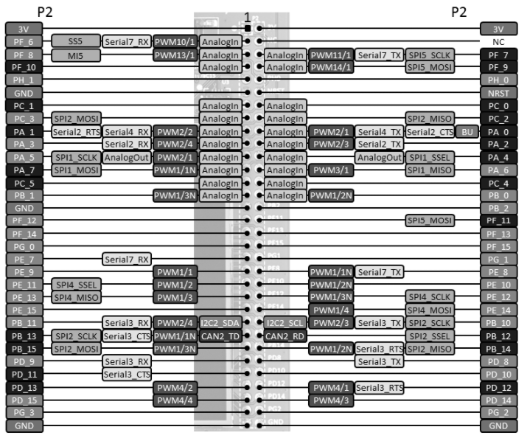
The STM32F4 Board
  P2 header

Slide 23
The STM32F4 Board
  Powering the Board and Programming the Microcontroller on It
  The microcontroller on the STM32F4 board can be programmed easily by the onboard ST-LINK/V2-B debugger/programmer. To do so, we should connect the board to PC via mini USB cable through its USB connector CN1.
  The USB connection for debugging/programming purposes can also be used to power the board.
  We can also use an external 5 V power supply to power the board.
  The STM32F4 microcontroller operates within voltage levels 1.8 V to 3.6 V.

